Slide 1


The
GREEN AREA
Presented By:
Anil Bhandari
Kalyan Babu Kafle
Saugat Adhikari
Nikisha Parajuli

Slide 2




Problem Statement
Due to deforestation, there have arised problem like:
biodiversity loss
climate change
desertification
soil erosion
reduced crop yields
flooding
elevated levels of atmospheric greenhouse gases.

Slide 3
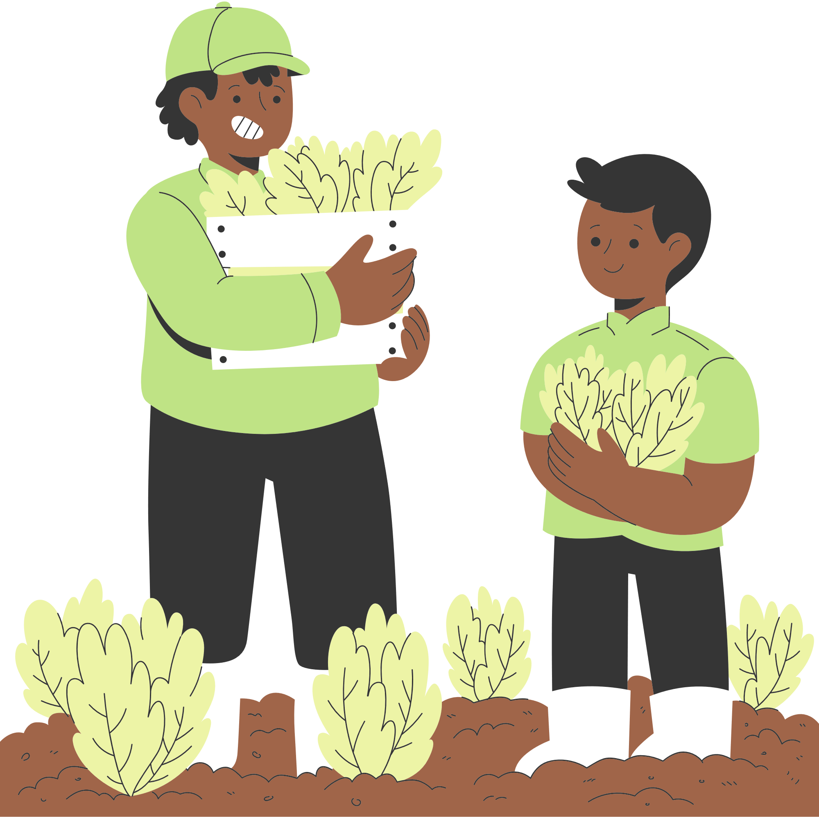
Project as a solution
Creates a community between plant preservers and local community.
Plant disease prediction.
Give platform to post of developmental works.

Slide 4



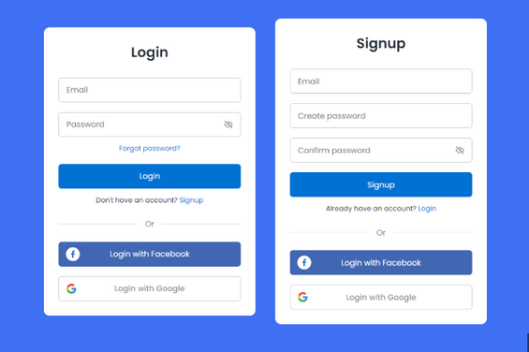

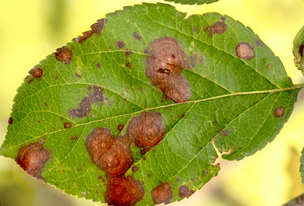
OUR FEATURES
Presentation Design

Slide 5
Technology Used
React - Frontend development
Node.js - Backend development
Flask
MongoDB

Slide 6
THE BUSINESS MODEL
Customer relationships
Key Activities
Upload post
Generate event
Detect disease
Locate areas in map
Certificates
Hiring expert
Gifts
Key Partners
Value Propositions
Customer segments
Investor
Customer
Admin
NGO
Networking
Career path
User friendly UI
Clean environment
Plant preservers
Local citizen
Key Resources
Channels
Business partner
capital
Event
Advertisement
Social media
Cost Structure
Revenue Streams
Website maintainance
Marketting
Salaries
Advertisement
License
Advertising
Subscription models
Sponsered content

Slide 7
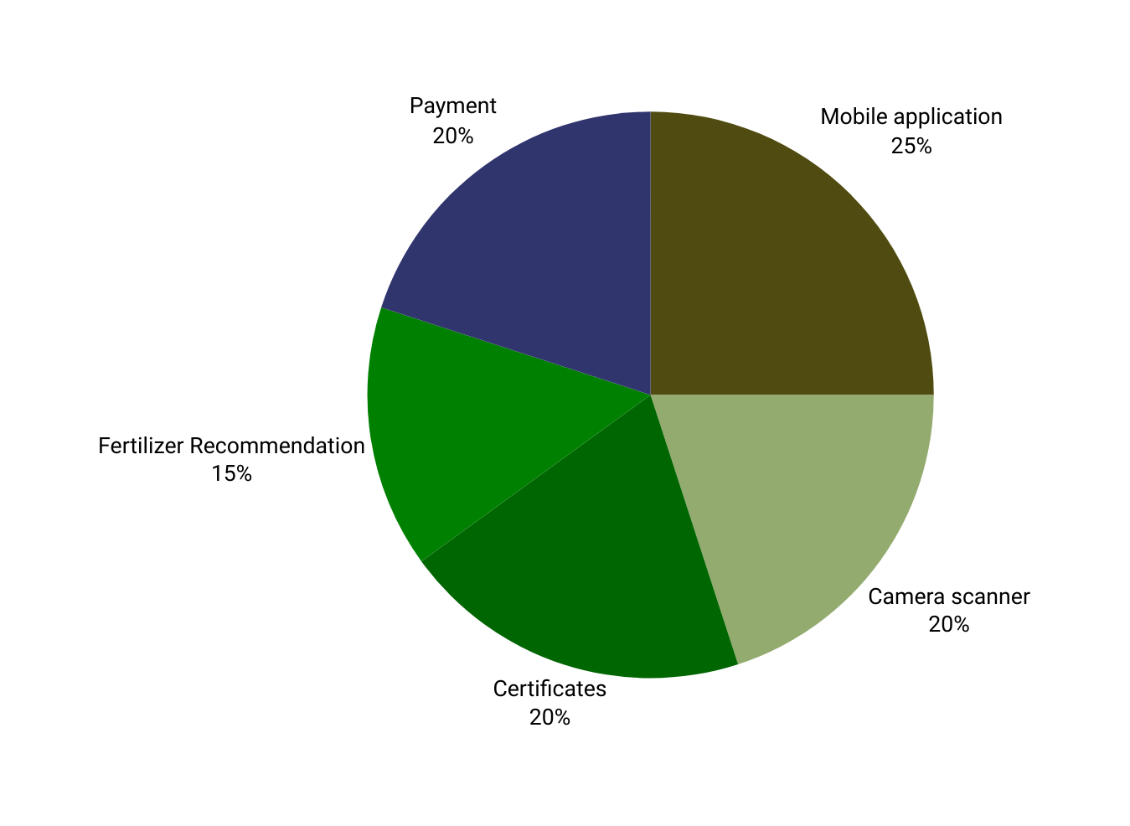
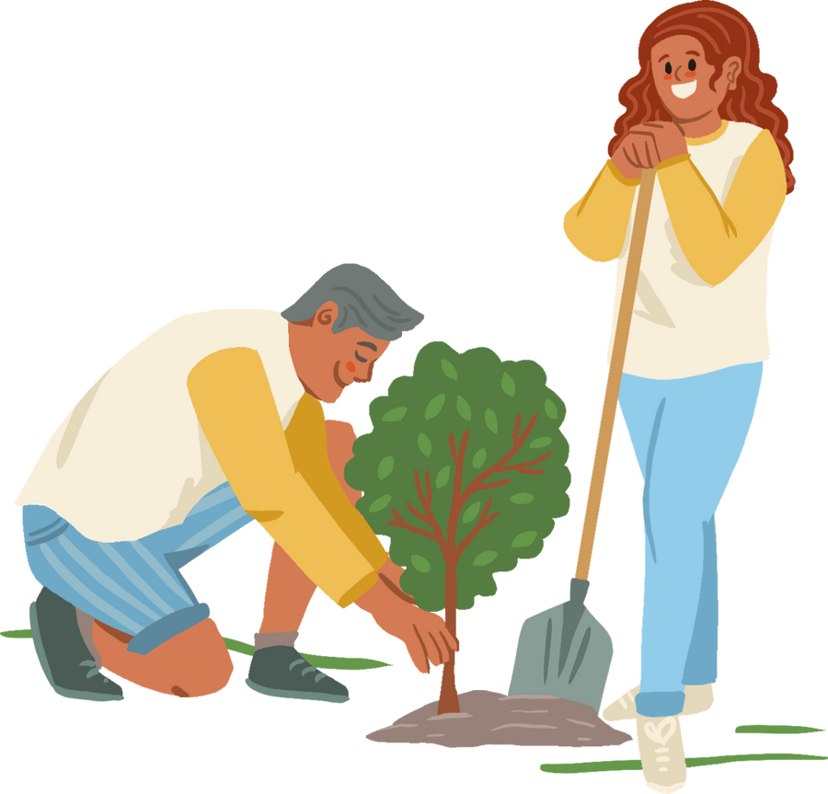

Future Works

Slide 8

The Green Area
Any questions?

